Slide 1
Bloom Filter for Private Look Up Tables
Thesis Exam
Erez Segev

Slide 2

Agenda
About
Objective
Bloom filters
Problem Statement & Motivation
Memory Comparison with Hash Table
Experimental results
Conclusions
Notes:
Duration: 15 min (limit is 8 min)
1. Captial T in Title
2. Co-Author's name on First Page
3. No space before , (comma)
4. coloring on page 5 same as arrow
5. Lets - Let's
6. comma missing between Add john smith0 and 01
7. All slides, add more color
8. Discuss idea in brief
9. Avoid long sentences
10. Hide the "Dynamic lookup" idea

Slide 3

About
Published as part of “BFLUT Bloom Filter for Private Look Up Tables” in the proceedings of the 6th International Symposium on Cyber Security, Cryptology, and Machine Learning, Springer, Lecture Notes in Computer Science 13301, 2022
Paper authors :
Prof. Shlomi Dolev - BGU
Prof. Ehud Gudes - BGU
Prof. Jeffrey Ullman – Stanford
Grisha Weintraub - BGU
Erez Segev - BGU

Slide 4

About
About myself …
Married to Miri
4 Kids – Yahav 20, Zohar – 18, Hodaya -16, Ohad 12
Lives in Kibbutz Shoval
Studied in BGU 1995-1998
26 years in the Hi-tech industry
Breezecom (Alvarion)
Exent
ECI
Ribbon

Slide 5
objectives
Suggests a new way for utilizing bloom filters for Look Up Table
Improving memory footprint
Memory consumption when using BFLUT if much better than Hash table lookup tables
Content is Pseudo Random product of cryptographic hash function
Privacy preserving
An adversary cannot learn anything about actual values
False positives are acceptable, while false negatives are not
Notes:
Pseudo Random - one that appears to be statistically random, despite having been produced by a completely deterministic and repeatable process

Slide 6
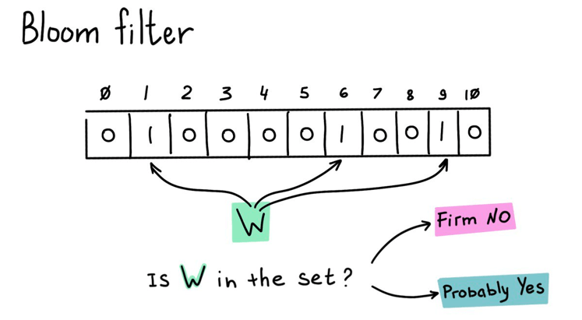
Bloom Filters
Supports method…
Create
Add
Test
With respect to test
If an item is in the set, the test will always return true
If an item is not in the set, the test might return true (aka false positive)
Rate of false positive is configurable – How?

Slide 7
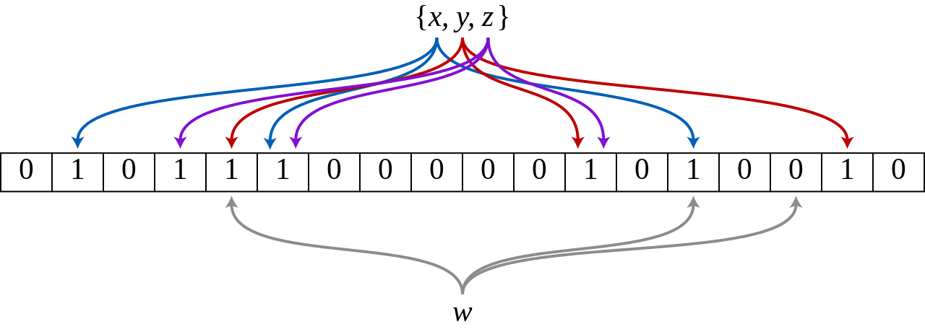
Bloom Filters
Properties:
k the number of hash functions
m size of the bloom filter in bits
CREATE a bit array of size m and initialize with 0s
ADD items - run k independent hash functions (H1,H2,H3) and set the corresponding entries in the bit array to 1
TEST - run k independent hash functions and check if the corresponding entries in the bit array are 1, if al are one return true, else return false
H1(x)
H3(x)
H2(x)
K =3
m =18
n = 3

Slide 8
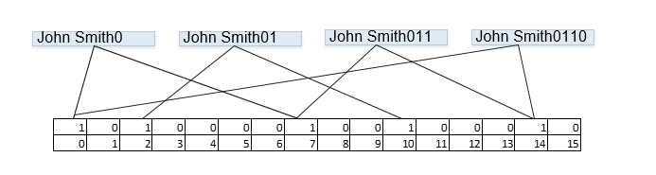
Bloom Filter as LUT - BFLUT
Let’s say we like to encode a spy “John Smith” with it’s address “0110”
So we shell perform the following add operations to BF:
Add “John Smith0” Add “John Smith01” , Add “John Smith011”, Add “John Smith0110”

Slide 9
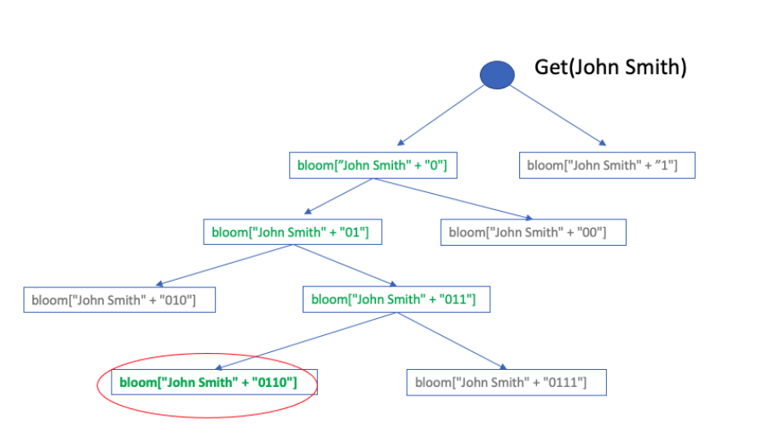
Look up
We like to extract the spy’s address from BF
We can extract wrong addresses as well
Notes:
חידוש – ניתן לשאול בצורה אקראית
הפחתת הסיכוי לש הבנת המאזין מה אני מחפש
האזנה לרצף השאלות בעייתית

Slide 10
BFLUT properties…
Privacy
The entire content of the BFLUT reveals nothing on the keys nor on the addresses prior to guessing the key and using the hash function to reveal the address(es)
Compact
Fit the cases in which one has a limited RAM memory
Pseudo Random content
Product of sha-xxx
Usable
The address can be anything.. disk locations, phone numbers ,IDs
Deniability
After the data structure is presented to the public, there is no definite proof that a certain element has been inserted into the BFLUT

Slide 11
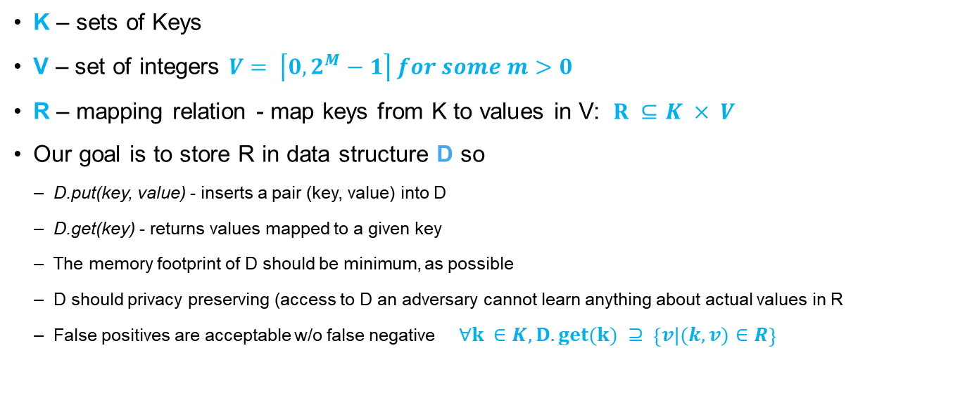
Problem Statement and Objectives
K – sets of Keys
V – set of integers $V= \left\lceil 0,2^{M}−1\right\rceil for some m>0$
R – mapping relation - map keys from K to values in V: $R ⊆K × V$
Our goal is to store R in data structure D so
D.put(key, value) - inserts a pair (key, value) into D
D.get(key) - returns values mapped to a given key
The memory footprint of D should be minimum, as possible
D should privacy preserving (access to D an adversary cannot learn anything about actual values in R
False positives are acceptable w/o false negative$∀k ∈K,D.get\left(k\right) ⊇ \left\{v | \left(k,v\right)∈R\right\}$

Slide 12
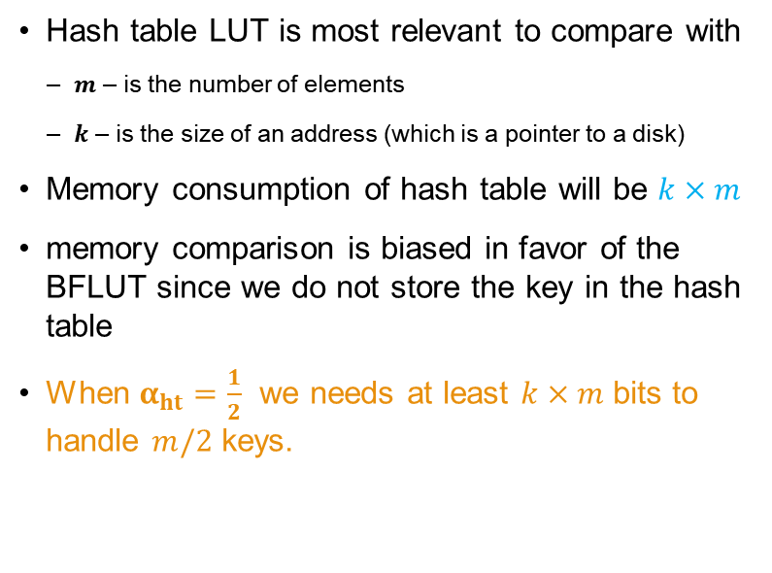
Open Addressing Hash Look Up Tables
Hash table LUT is most relevant to compare with
$m$ – is the number of elements
$k$ – is the size of an address (which is a pointer to a disk)
Memory consumption of hash table will be $k×m$
memory comparison is biased in favor of the BFLUT since we do not store the key in the hash table
When $α_{ht}=\frac{1}{2}$ we needs at least $k×m$ bits to handle $m/2$ keys.
K bits
,
01001101001110
m
0110
‘John Smith’
Notes:
Cost of query is high
שומר פוינטר שמעיד על ה key והערכ שאני מחפש
When $α_{ht}=\frac{1}{2}$ we needs at least $k×m$ bits to handle $m/2$ keys.

Slide 13
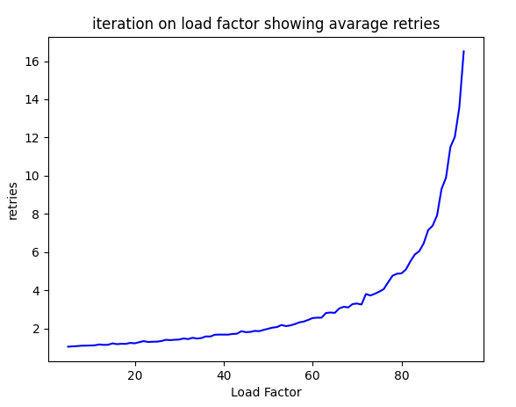
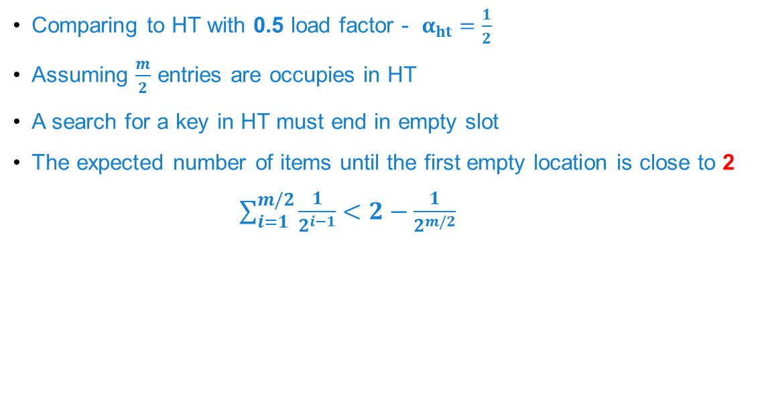
HT with 0.5 load factor
Comparing to HT with 0.5 load factor - $α_{ht}=\frac{1}{2}$
Assuming $\frac{m}{2}$ entries are occupies in HT
A search for a key in HT must end in empty slot
The expected number of items until the first empty location is close to 2
$\sum_{i=1}^{m/2}{\frac{1}{2^{i−1}}<2−\frac{1}{2^{m/2}}}$
HT
Notes:
המשחק הוא שכל כניסה שאינה ריקה, יכולה להיות כתובת בדיסק שצריך לבדוק
כיוון שהאיבר הוכנס קודם, בטוח שהכניסה שנבחן ראשונה מלאה, אבל אולי על ידי מישהו שהוכנס לפניו
ברור שהמקום הראשון שנבדוק יהיה מלא (כיוון שההנחה שהאיבר שמחפשים הוכנס קודם)

Slide 14
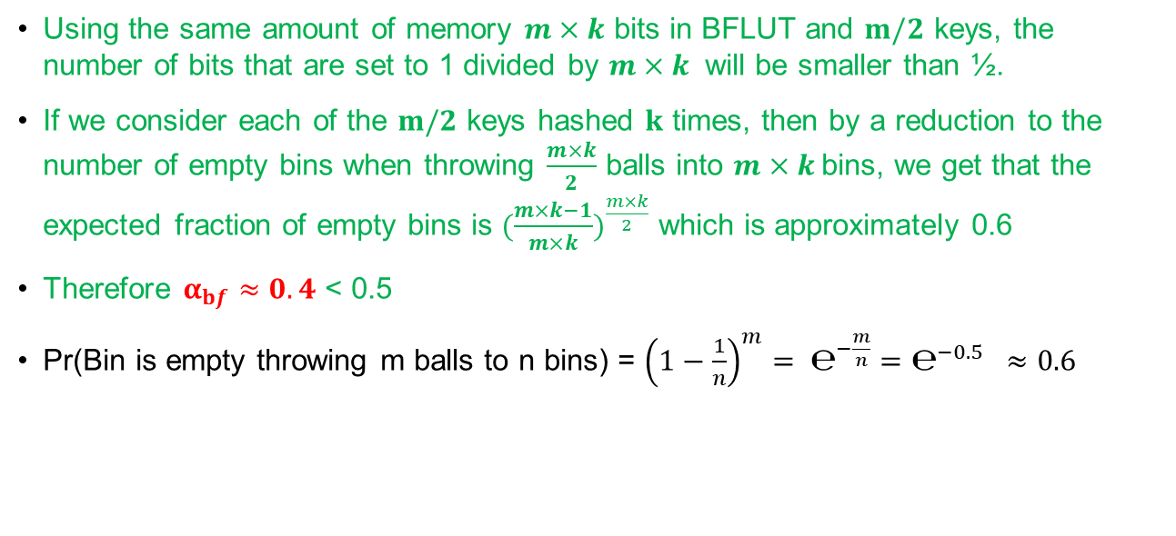
BFLUT with 1 hash
Using the same amount of memory $m×k$ bits in BFLUT and $m/2$ keys, the number of bits that are set to 1 divided by $m×k$ will be smaller than ½.
If we consider each of the $m/2$ keys hashed $k$ times, then by a reduction to the number of empty bins when throwing $\frac{m×k}{2}$ balls into $m×k$bins, we get that the expected fraction of empty bins is ${(\frac{m×k−1}{m×k})}^{\frac{m×k}{2}}$ which is approximately 0.6
Therefore $α_{bf}≈0.4$ < 0.5
Pr(Bin is empty throwing m balls to n bins) = ${\left(1−\frac{1}{n}\right)}^{m}= ℮^{−\frac{m}{n}}=℮^{−0.5} ≈0.6$
Notes:
Note: Pr(Bin is empty throwing m balls to n bins) = ${\left(1−\frac{1}{n}\right)}^{m}= ℮^{−\frac{m}{n}}$

Slide 15
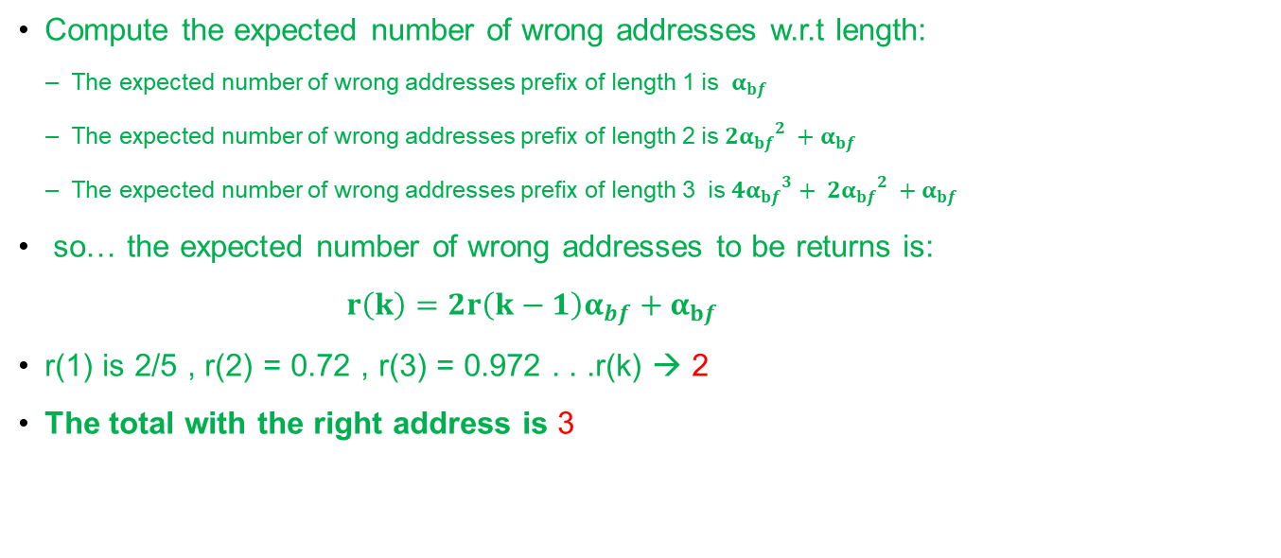
BFLUT with 1 hash
Compute the expected number of wrong addresses w.r.t length:
The expected number of wrong addresses prefix of length 1 is $α_{bf}$
The expected number of wrong addresses prefix of length 2 is ${{{2α}_{bf}}^{2} +α}_{bf}$
The expected number of wrong addresses prefix of length 3 is ${{{4α}_{bf}}^{3}+ {{2α}_{bf}}^{2} +α}_{bf}$
so… the expected number of wrong addresses to be returns is:
${r\left(k\right)=2r\left(k−1\right)α_{bf}+α}_{bf}$
r(1) is 2/5 , r(2) = 0.72 , r(3) = 0.972 . . .r(k) → 2
The total with the right address is 3
BF

Slide 16
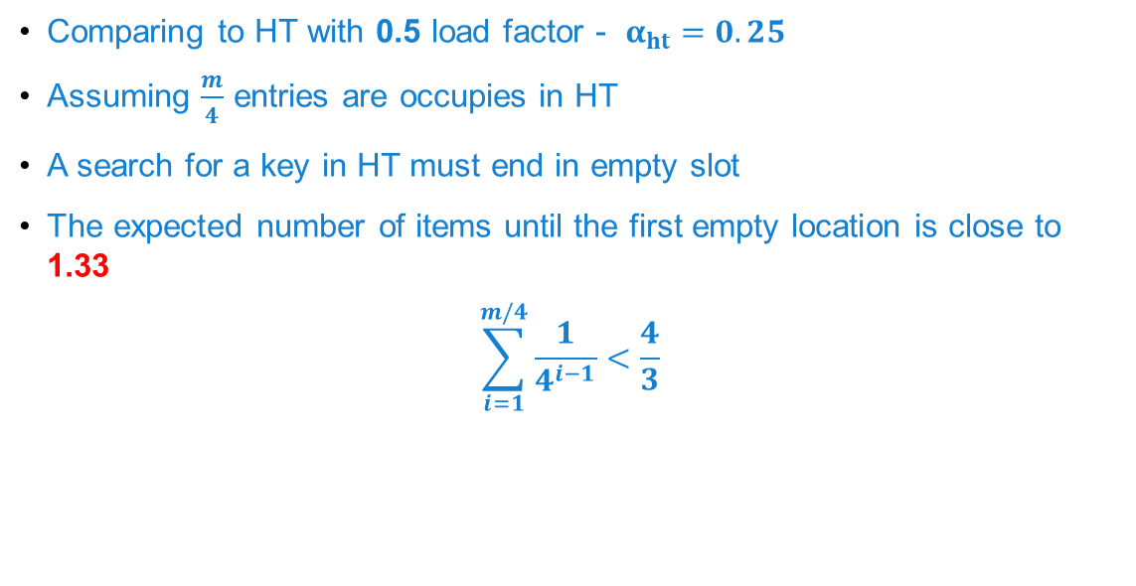
HT with 0.25 Load Factor
Comparing to HT with 0.5 load factor - $α_{ht}=0.25$
Assuming $\frac{m}{4}$ entries are occupies in HT
A search for a key in HT must end in empty slot
The expected number of items until the first empty location is close to 1.33
$$\sum_{i=1}^{m/4}{\frac{1}{4^{i−1}}<\frac{4}{3}}$$
HT
Notes:
המשחק הוא שכל כניסה שאינה ריקה, יכולה להיות כתובת בדיסק שצריך לבדוק
כיוון שהאיבר הוכנס קודם, בטוח שהכניסה שנבחן ראשונה מלאה, אבל אולי על ידי מישהו שהוכנס לפניו
ברור שהמקום הראשון שנבדוק יהיה מלא (כיוון שההנחה שהאיבר שמחפשים הוכנס קודם)

Slide 17
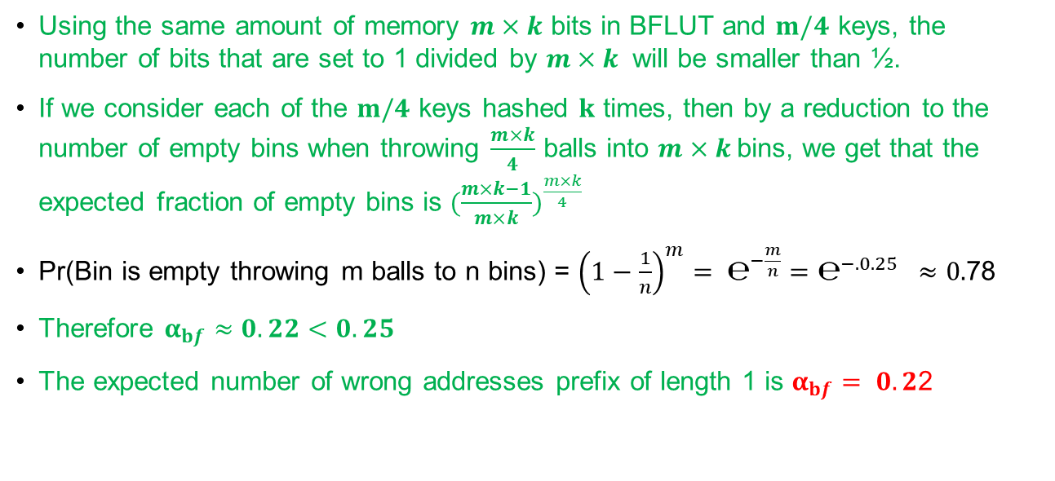
BFLUT with 1 hash
Using the same amount of memory $m×k$ bits in BFLUT and $m/4$ keys, the number of bits that are set to 1 divided by $m×k$ will be smaller than ½.
If we consider each of the $m/4$ keys hashed $k$ times, then by a reduction to the number of empty bins when throwing $\frac{m×k}{4}$ balls into $m×k$bins, we get that the expected fraction of empty bins is ${(\frac{m×k−1}{m×k})}^{\frac{m×k}{4}}$
Pr(Bin is empty throwing m balls to n bins) = ${\left(1−\frac{1}{n}\right)}^{m}= ℮^{−\frac{m}{n}}=℮^{−.0.25} ≈0.$78
Therefore $α_{bf}≈0.22<0.25$
The expected number of wrong addresses prefix of length 1 is $α_{bf}= 0.2$2
Notes:
Note: Pr(Bin is empty throwing m balls to n bins) = ${\left(1−\frac{1}{n}\right)}^{m}= ℮^{−\frac{m}{n}}$

Slide 18
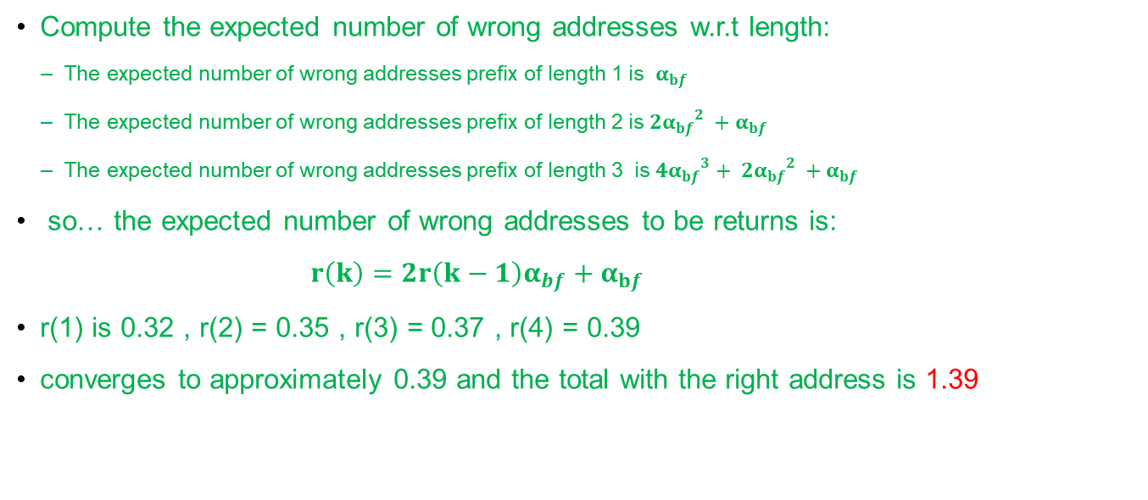
BFLUT with 1 hash
Compute the expected number of wrong addresses w.r.t length:
The expected number of wrong addresses prefix of length 1 is $α_{bf}$
The expected number of wrong addresses prefix of length 2 is ${{{2α}_{bf}}^{2} +α}_{bf}$
The expected number of wrong addresses prefix of length 3 is ${{{4α}_{bf}}^{3}+ {{2α}_{bf}}^{2} +α}_{bf}$
so… the expected number of wrong addresses to be returns is:
${r\left(k\right)=2r\left(k−1\right)α_{bf}+α}_{bf}$
r(1) is 0.32 , r(2) = 0.35 , r(3) = 0.37 , r(4) = 0.39
converges to approximately 0.39 and the total with the right address is 1.39
BF

Slide 19

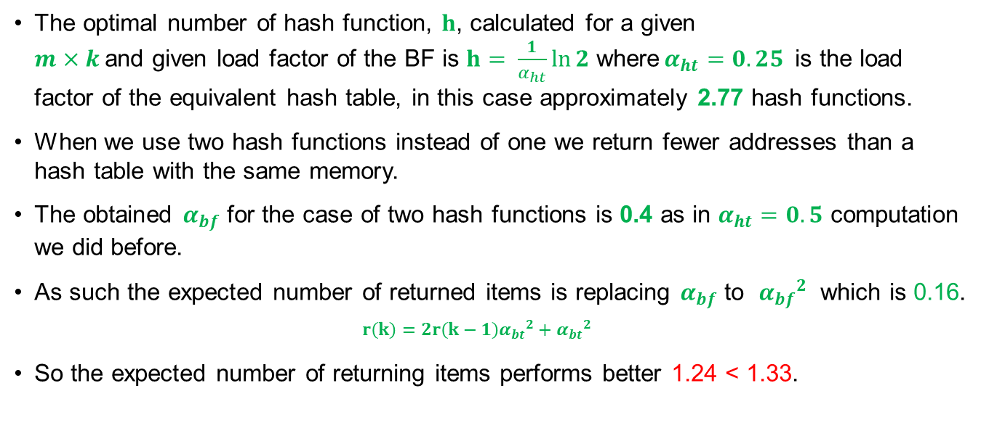
Raising to 2 Hashes
The optimal number of hash function, $h$, calculated for a given $m×k$and given load factor of the BF is $h= \frac{1}{α_{ht}}\ln{2}$ where$α_{ht}=0.25$ is the load factor of the equivalent hash table, in this case approximately 2.77 hash functions.
When we use two hash functions instead of one we return fewer addresses than a hash table with the same memory.
The obtained $α_{bf}$ for the case of two hash functions is 0.4 as in $α_{ht}=0.5$ computation we did before.
As such the expected number of returned items is replacing $α_{bf}$ to ${α_{bf}}^{2}$ which is 0.16.
$${r\left(k\right)=2r\left(k−1\right){α_{bt}}^{2}+{α_{bt}}^{2}}_{}$$
So the expected number of returning items performs better 1.24 < 1.33.

Slide 20
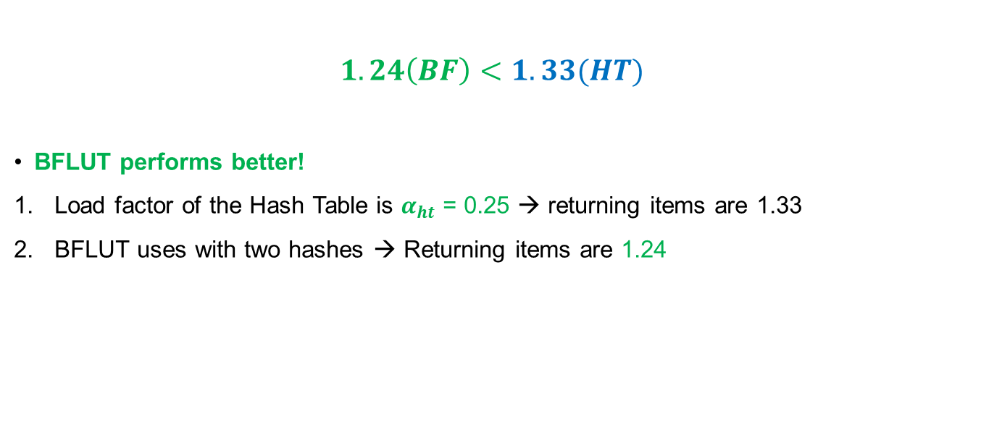
Conclusions
$$1.24\left(BF\right)<1.33(HT)$$
BFLUT performs better!
Load factor of the Hash Table is $α_{ht}$ = 0.25 → returning items are 1.33
BFLUT uses with two hashes → Returning items are 1.24
Notes:
להוסיף גביע

Slide 21
Experiment results
We build a setup in which we retrieve address as a function of a key.
The key is a 32 bytes randomly generated while the address is a 10 bytes long randomly selected and attached to one of the keys.
We used two approaches to manage the bloom filter object,
Computing the size and number of hashes to perform
Fixed size and number of hashes while inserting specific number of key-addresses to it.
We also used two approaches for inserting values one was single BF instance and the other is multi instances of BF

Slide 22
HT Simulation: number of items until first empty location
HT
Our Test Cases
1.332
1.984

Slide 23
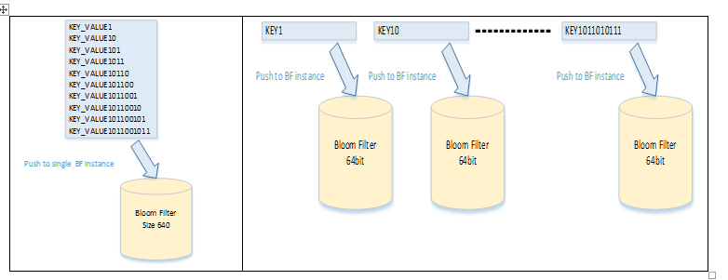
Two methods

Slide 24
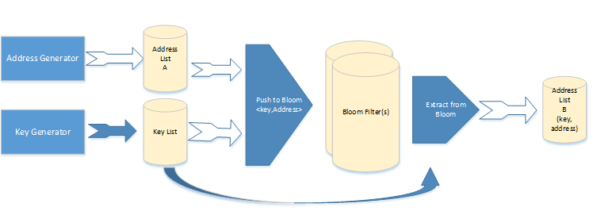
Test setup

Slide 25
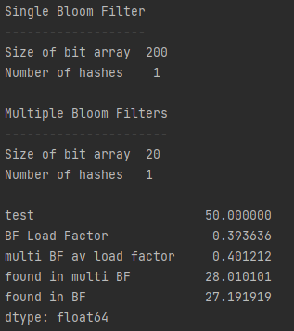
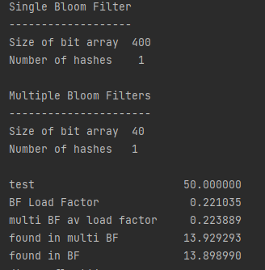
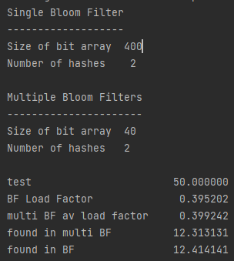
Test Results
Load Factor 50% single Hash
Push 10 items to 200bit structure
Load Factor 25% double Hash
Push 10 items to 400bit structure
Load Factor 25% single Hash
Push 10 items to 400bit structure
Close to ~3 factor that we found
In this scenario we win HT!!
Match the 1.39 that we found

Slide 26
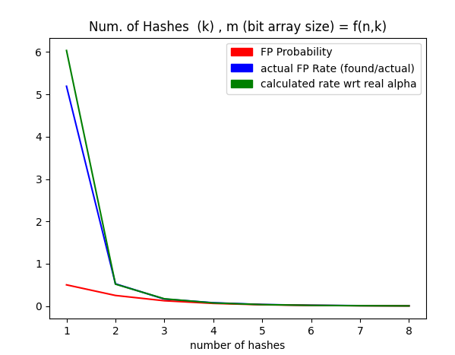
Results example – single BF approach
The FP rate probability is dropping when raising the number of hash functions

Slide 27
Conclusions
We presented a basic data structure that implements a dynamic look-up table that is based on Bloom Filter.
Innovative approach to use Bloom Filters for privacy-preserving lookup table implementation without false-negative responses.
scheme advantages:
Privacy without the need to use encryption keys
Multiple users can update the data structure even if they do not share a key
Deniability - after the data structure is presented to the public, there is no definite proof that a certain element has been inserted into the BFLUT
Usability – stored value is flexible
Pseudo Random product - when using proper cryptographic hash function

Slide 29
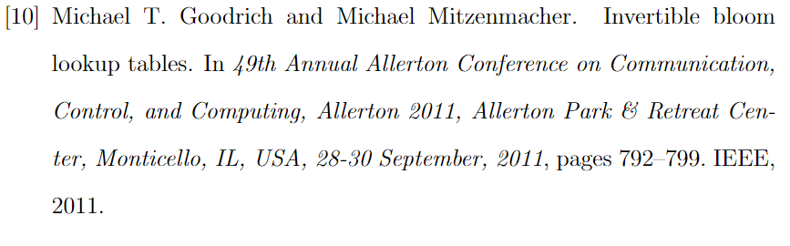
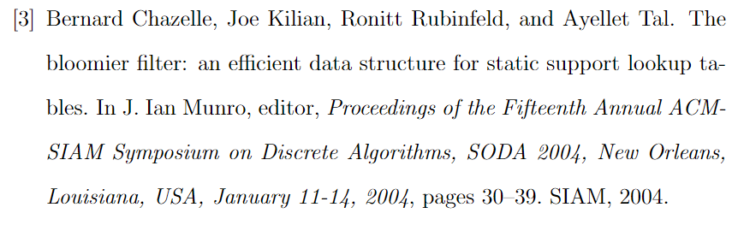
Related Work
Invertible Bloom lookup table [10] and the Bloomier filter [3]:
Similar motivation to ours
Do not support multiple values per key
Can return false negatives to the lookup queries which not acceptable in our system model.

Slide 30
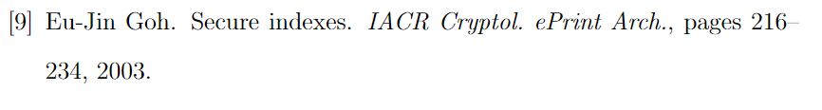
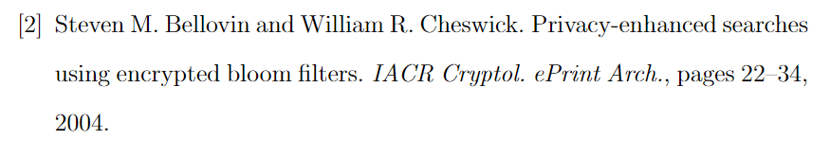
Related Work
Encrypted Bloom Filters are used in [9] and [2]
Implement a secure inverted index, with standard Bloom Filter
Checks if a particular keyword belongs to a particular document
(hence the number of Bloom Filters is equal to the number of documents).
In our approach, we use a single data structure to get all the values assigned to a particular key.

Slide 31
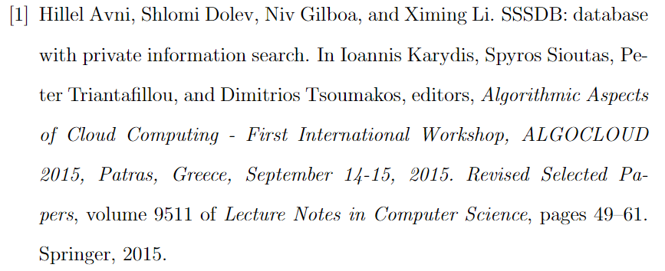
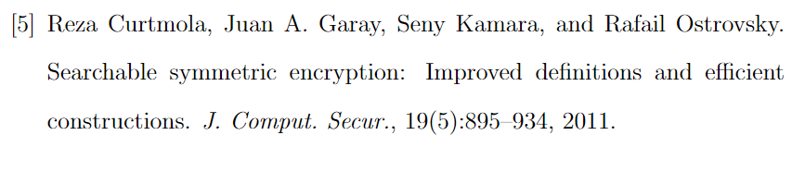
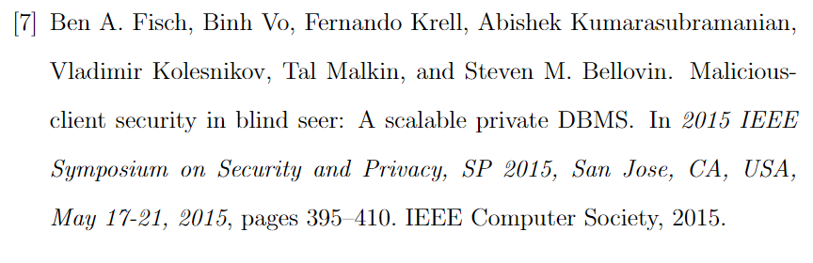
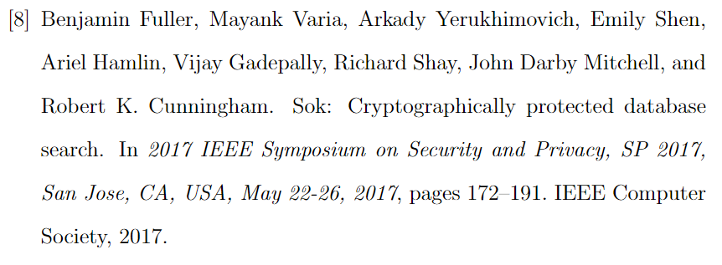
Related Work
“Searchable encryption” [1, 5, 7, 8] is a related (yet orthogonal) topic to our research, as it is mainly focused on developing secure protocols and databases rather than basic data structures. Our data structure can be used as a building block for these schemes.
To the best of our knowledge, our approach is the first to use Bloom Filters for privacy-preserving lookup table implementation without false-negative responses.

Slide 32
Confidentiality: Only the intended recipients can understand the contents of a message (almost always achieved through encryption).
Integrity: The message will be delivered without alterations; and if it is, the recipient will know to reject it.
Availability: Authorized users will have access to the resources they need (i.e. a medium they can communicate through).
Authenticity: In a group communication protocol, you want to ensure you can validate which participant sent each message. This is loosely related to, yet independent from, integrity.
Non-Repudiation: An extension of authenticity, wherein you cannot deny that you sent a message after you sent it; it’s provable that you sent it.
Deniability: The complement to non-repudiation, wherein you can prove that you sent a message to your recipient, and then at a future time make it possible for other participants to have forged the message.

Slide 33
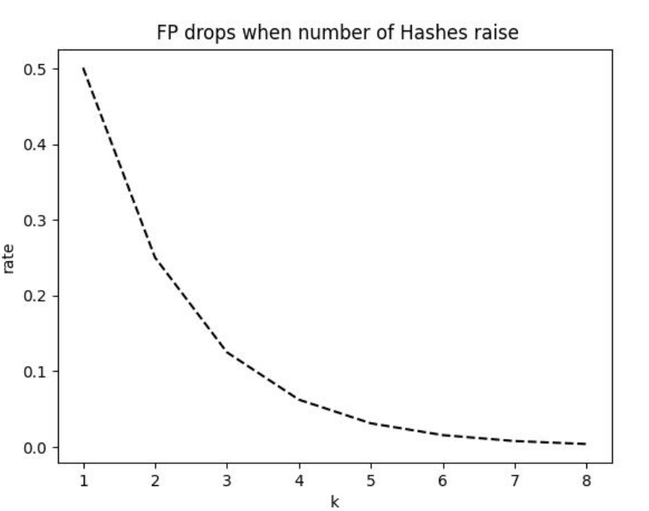
False Positive Drop
Elements pushed to BF(n) - 16
Load Factor ~ 0.4
Hashes (k) - 1-8
Size of array f(k,n)
Size of array grows with respect to

